Slide 1
Investment evolution
ICO / STO / IEO

Slide 2
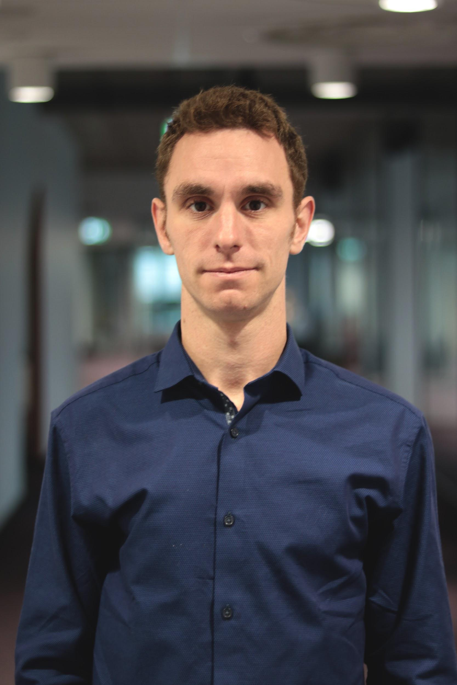
Crypto enthusiast since 2014
Co-founder private investment syndicate
(MLC)
CBDO CoinStruction
COO Atomind, Robotics and A.I. VC

Slide 3
Initial Coin Offering
ICO

Slide 4
What is an ‘ICO’?
Initial Coin Offering is a method of fundraising without having to give away ownership of your company to the investors.
The funding process goes from:
Seed phase
=> private sale
=> public presale
=> public sale (rounds)
Utility token

Slide 5
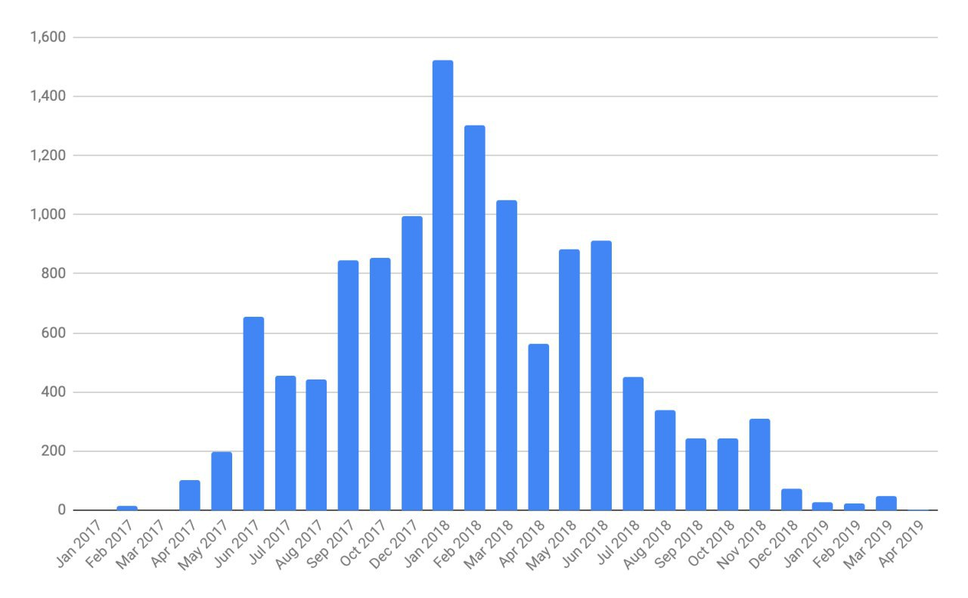
ICO fundraise results

Slide 6
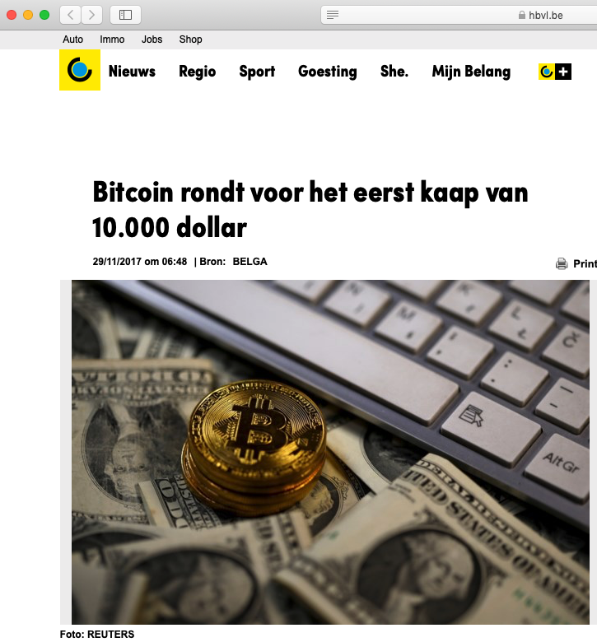
Bitcoin reaches $10.000, 29th November 2017, 06:48 AM

Slide 7
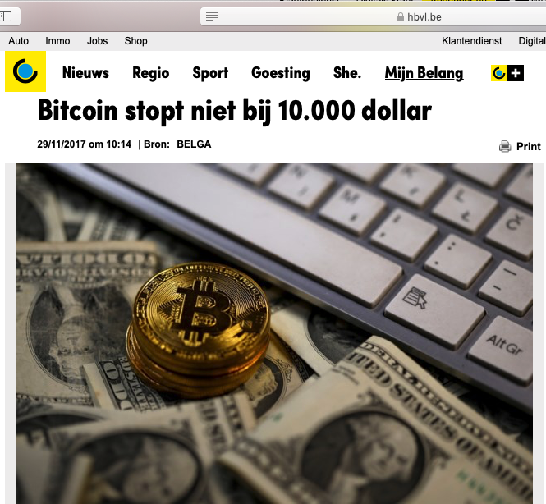
Bitcoin doesn’t stop at $10.000 29th November 2017, 10:14AM

Slide 8
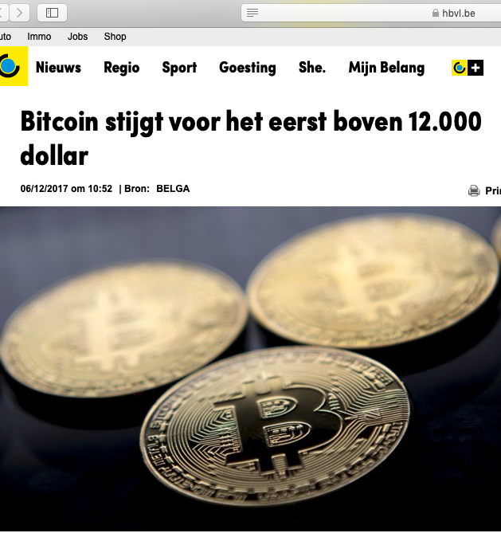
Bitcoin grows above $12.000, 6th December 2017

Slide 9
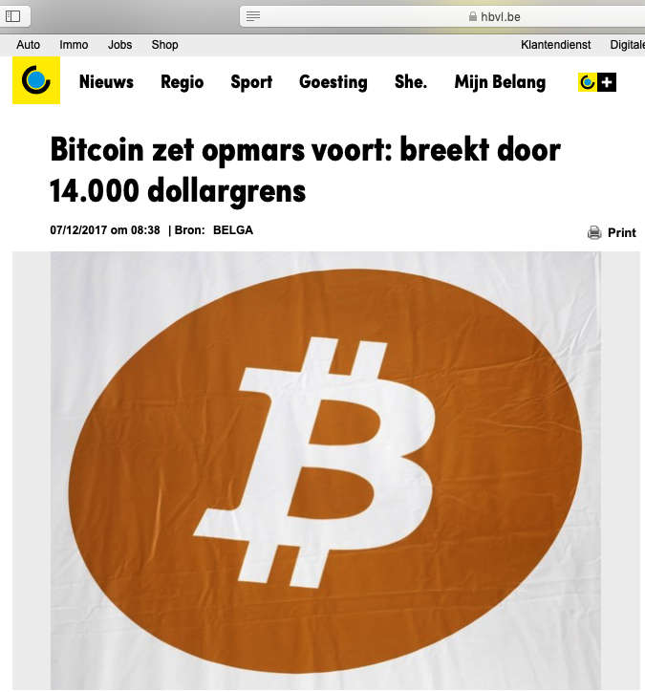
Bitcoin breaks $14,000
7th December 2017

Slide 10
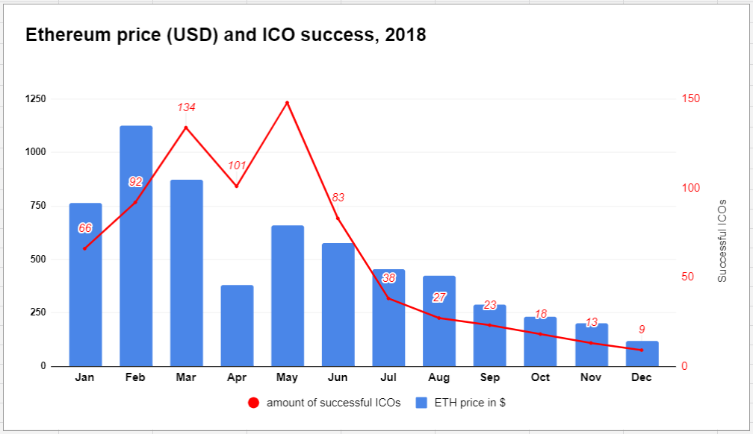

Slide 11
ROI went down
SAFT conditions
Bounty / Airdrop
Influencers
Project management gambels
Problem
Extreme bonuses, vesting periods too short. Peg pricing.
When Exchange?
Had influence..
Not converting after each sale round.

Slide 12
Security Token Offering
STO

Slide 13
Howey Test
A security is found to exist if all 4 of these elements exist:
Investment with money
In a common enterprise
With an expectation of profits
From the effort of others

Slide 14
Problem listing the token
The wallet does not support the feature of the token.
(voting, debidents, profit shares, …)
Regulated security token exchange
Security of the exchange / wallet

Slide 15
Solution
Develop wallet and exchange yourself
Closed ecosystem
Private blockchain

Slide 16
Initial Exchange Offering
IEO

Slide 17
Responsibilities of the exchange
Legal opinion
Due Diligence
Withdraw of tokens disabled

Slide 18
Transparency problems
Regulations ⇔ Minor exchanges
Multiple launchpads
Token swap

Slide 19
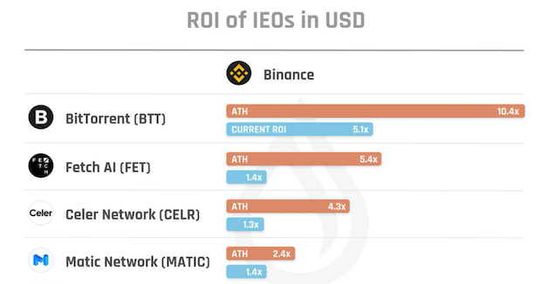
Return of Investment ($) Binance

Slide 20
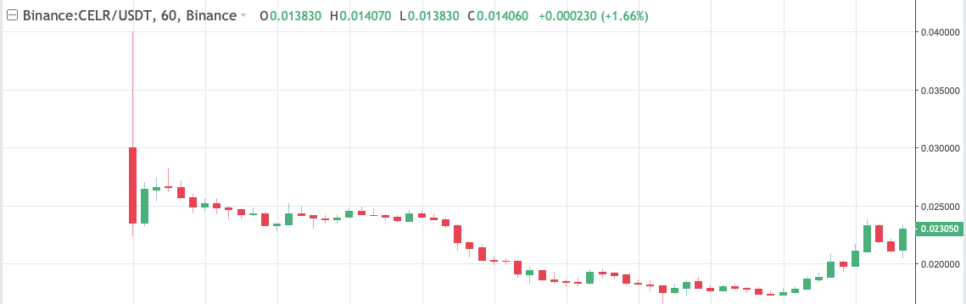
Celer IEO

Slide 21
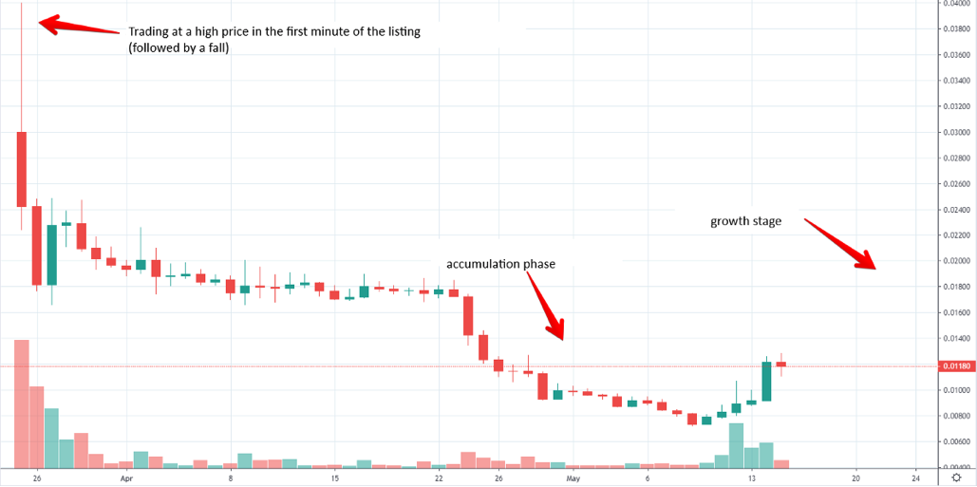
Price Dynamic of Projects After IEO
Notes:
After listing on the exchange, most projects have the following dynamics:
Trading at a high price in the first minute of the listing followed by a fall and the ability to sell tokens with a 100%+ RO
Accumulation phase, which can go for several months or days depending on different conditions.
The beginning of the growth stage if the project has a long-term perspective.

Slide 22
Contact
Linkedin: Waton Christof
Telegram:
@cryptowaton
Whatsapp:
+32468215255

